Slide 1
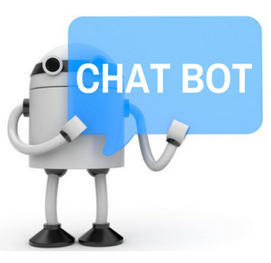

Intelligence Chat Bot System for College
GROUP MEMBERS
Ganesh Raghav
Dilip Saroj
3. Salman shaikh
Under guidence of: Ashraf siddiqui
THEEM COLLEGE OF ENGINEERING

Slide 2
CONTENTS :
Introduction
Implementation / Testing
Results and Discussion
Conclusion
References
Queries

Slide 3
INTRODUCTION
A chat bot (also known as a talk bot, Bot, chatterbox, Artificial Conversational Entity) is a computer program which conduct conversation via auditory or textual methods.
College Enquiry Chat Bot project will be built using artificial intelligence algorithms that will analyze user’s queries and understand user’s message.
This system will be a web application which will provide answers to the queries of the students. Students will just have to select the category for the department queries and then ask the query to the bot that will be used for chatting.

Slide 4
IMPLEMENTATION
The main language used to develop demonstrator of this paper is Java Script,HTML. Visual studio 10 is one of the best platform for creating the windows based application.It is easy to use because lots of drag and drop tools available.
Initially you have register youself with credintals.
1.Ask questions
2.Compare the inputs
3.Give output to the users
Suppose answer is not found then you can submit your query via google form

Slide 5
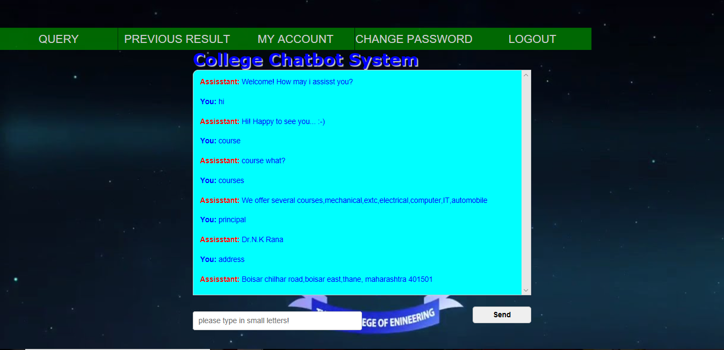
Testing Chatbot Interface

Slide 6
REFERENCE
J. Bang, H. Noh, Y. Kim and G. G. Lee, "Example-based chatoriented dialogue system with personalized long-term memory," 2015 International Conference on Big Data and Smart Computing (BIGCOMP), Jeju, 2015.
[2] E. Haller and T. Rebedea, "Designing a Chat-bot that Simulates an Historical Figure," 2013 19th International Conference on Control Systems and Computer Science, Bucharest, 2013.
[3] S. J. du Preez, M. Lall and S. Sinha, "An intelligent web-based voice chat bot," EUROCON 2009, EUROCON '09. IEEE, St.- Petersburg, 2009.
[4] Y. Chen, W. Wang and Z. Liu, "Keyword-based search and exploration on databases," 2011 IEEE 27th International Conference on Data Engineering, Hannover, 2011.

Slide 7
CONCLUSION
We are going to implement an intelligent chat bot system for College, which will gives an appropriate response to user’s query. It is an intelligent system which will think like human beings. This system will be helpful in reducing workload of employees. Due to an AIML files accurate and quick answers will be given to user. ICB system will take both voice as well as text as an input. If person is not having knowledge about the typing of particular language the system provides voice input facility.The core use of threads allows multiple processing of incoming and outgoing messages to occur without having to create a waiting scenario or unavailable server due to over use or possible congestion. ICB will be having effective GUI and animation, so that the user feels that he will talking with another person

Slide 8


